Slide 1


Programming Project 2 Real and Fake Detection
Jasmine Roberts
Bowie State University
CTEC-445-101
Dr.Haydar
9/17/2024

Slide 2


Tables Of Contents
Introduction
Lines of Code
Step 1
Step 2
Resize Images Code
Lines 1-32
Lines 34-38
Python Program For Real and Fake Detection Code
Lines 1-50
Results

Slide 3
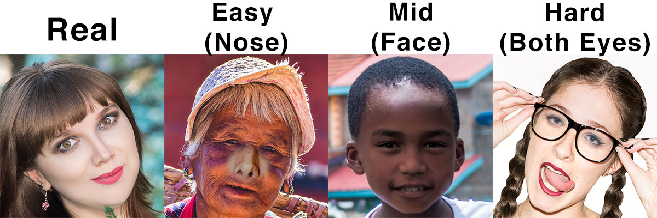
Introduction
Programming Project 2 consisted of programming, plotting the accuracy and loss results
We downloaded a dataset from Real and Fake Detection | Kaggle.
We used these images to train and test the model
They were resized and saved to a folder in the C drive of our computer

Slide 4

Lines Of Code

Slide 5
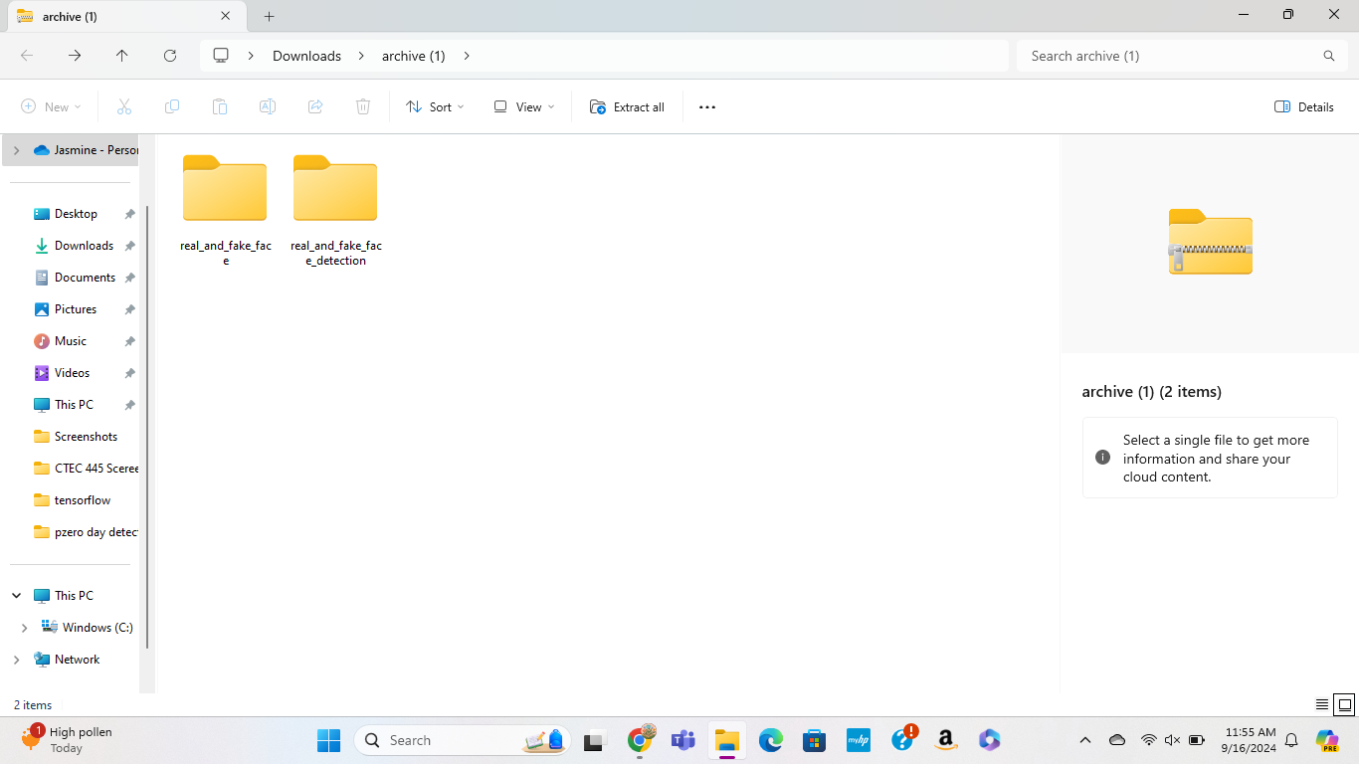
Step 1: Uploading All Images to C Drive
Download the images from Kraggle
Save them to as a folder in your C drive

Slide 6
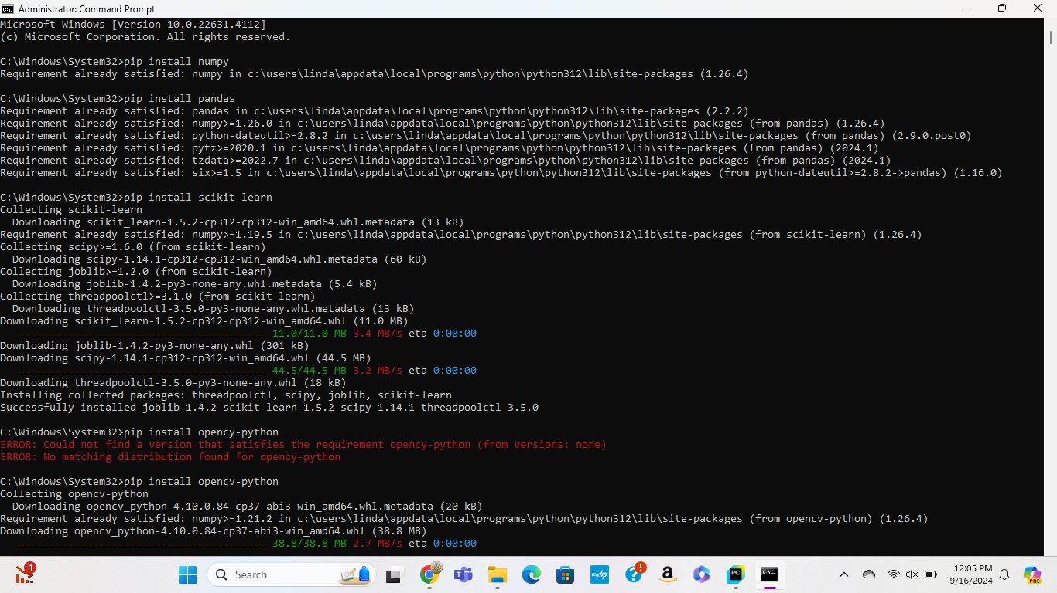
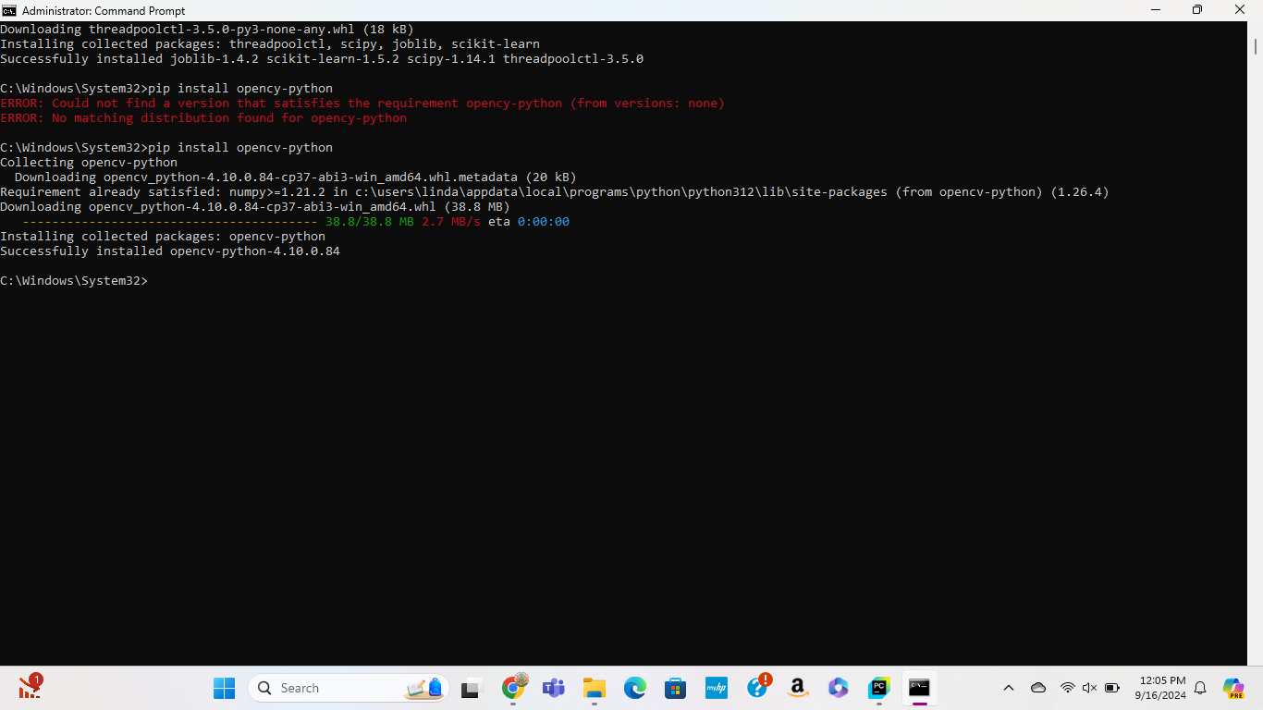
Step2: Downloading Required Algorithms
The algorithms we needed were:
Native Bayes
K-Nearest Neighbor
Decision Tree
Logistic Regression

Slide 7

Python Program to Resize All Images
This Photo by Unknown Author is licensed under CC BY-SA

Slide 8
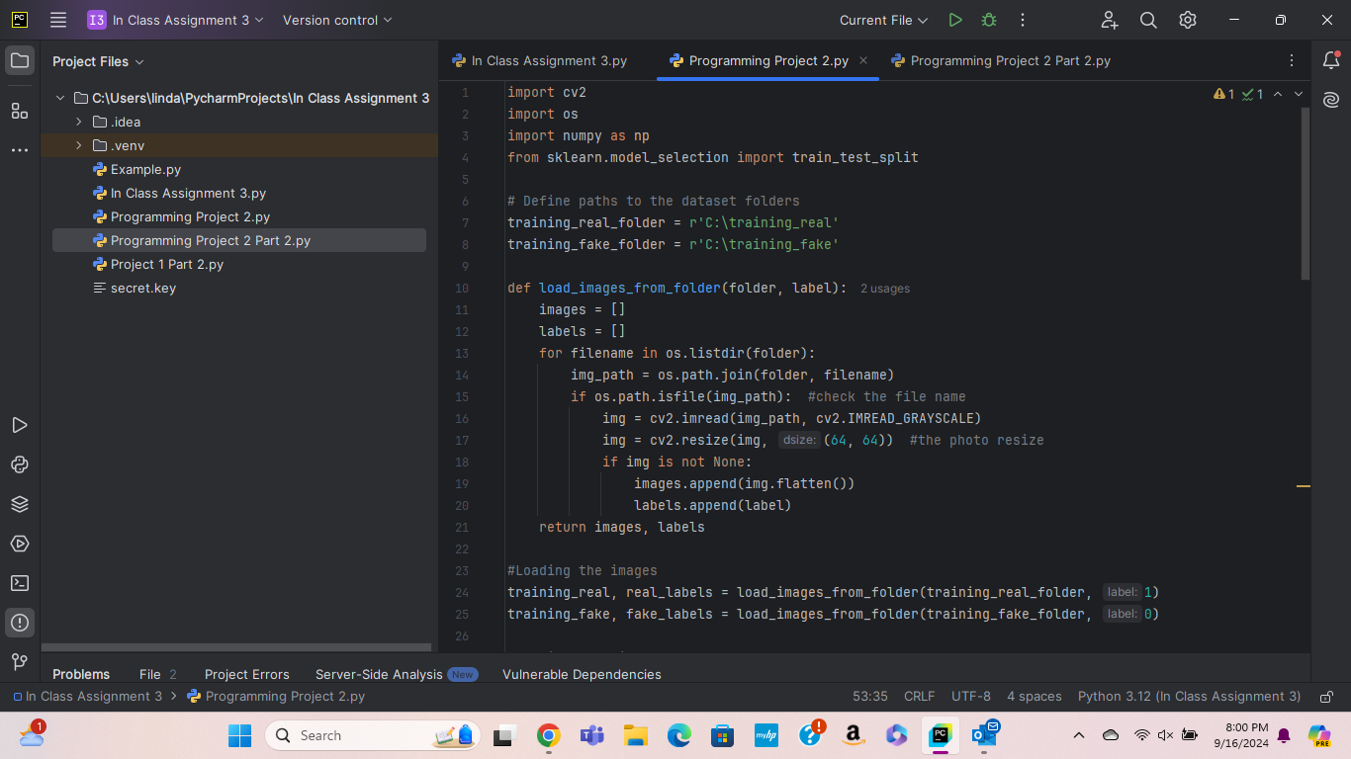
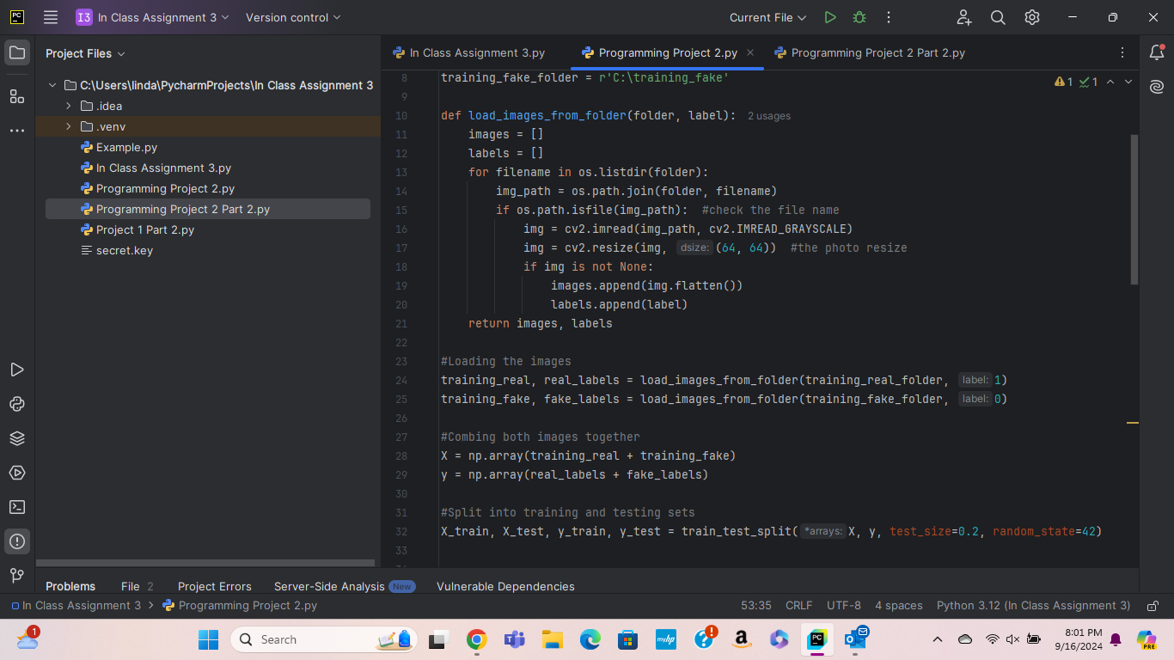
Import cv2 is a function to import OpenCV libraries for the detection and processing
Import os is importing the program and/or module
Import numpy as np is for number inside of the python program
from sklearn.model_selection import train_test_split is for testing the data inside of the program
Lines 1-32
training_real_folder = this file name inside of my C drive
r’C:\training_real’ is the C file path of the folder inside of my C drive
training_fake_folder = this file name inside of my C drive
r’C:\training_fake’ is the C file path inside of my C drive
Def load images_from_ folder(folder, label): is the load images function to load the images from selected folder
Images[] and labels[] is the selected image and labels of the folder
For filename in os.listdr(folder):
Img_path = os.path.join(folder, filename)
If os.path.isfile(imag_path): is the function to check the file name of each folder

Slide 9
Lines 1-32 Contin.
Line 16-21:
- This is the function to resize the images
Line 24-25:
This is the function to load the images from each folder (real and fake)
Line 28-32:
The first function is to combine both images together, and
The second function is to split both into training and testing sets

Slide 10
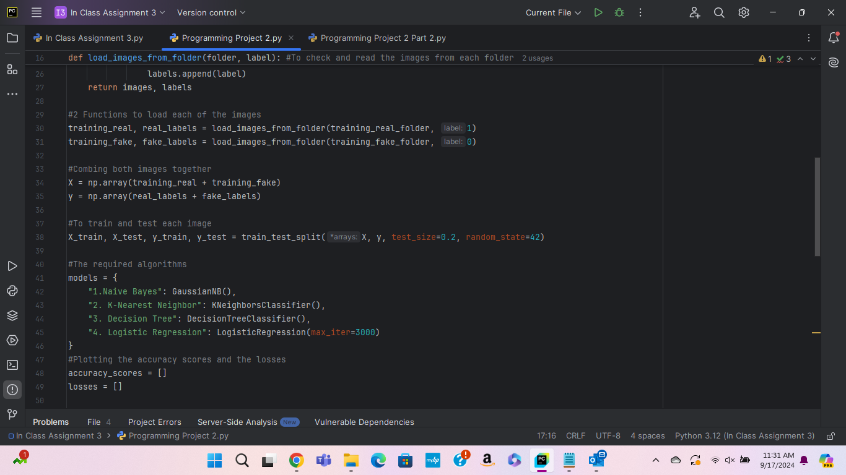
Lines 34-38
Lines 34-38:
- The first function is to combine both images together, and the second function is to split both into training and testing sets.

Slide 11
Python Program For Real and Fake Detection

Slide 12
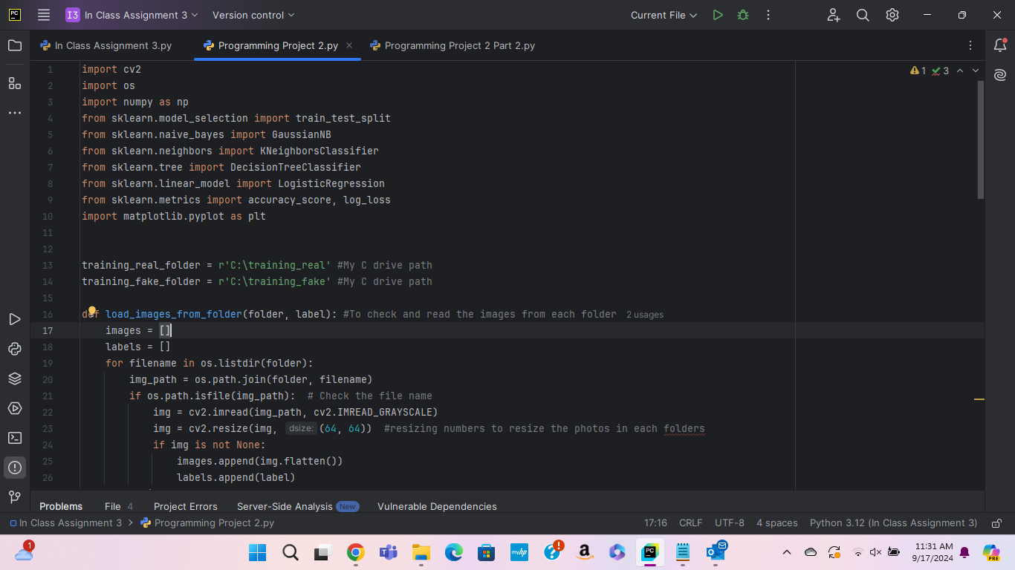
Lines 1-50
Lines 1-10:
- The required algorithms
Lines 11-27:
Functions to import the required algorithms
The function to plot the accuracy and the losses
These functions is to plot the accuracy scores and the losses
Predict proba is for the columns and the arrays with the detection , and to plot each result
Lines 33-49:
The first function is to combine both images together, and the second function is to split both into training and testing sets.
The models (names) of the headings of the chart
The functions to train and test both images

Slide 13
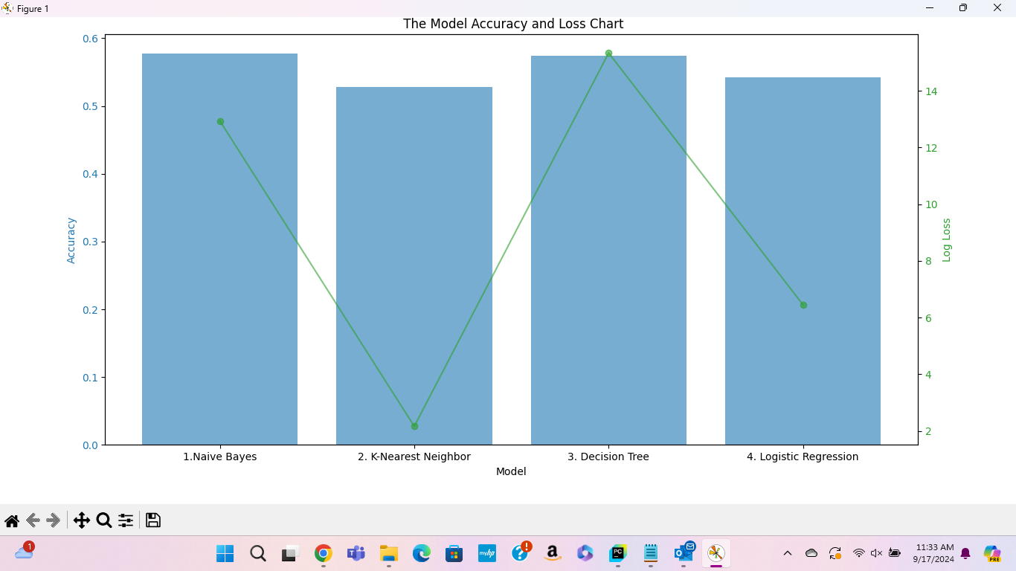
Results

Slide 14
THE END

